Slide 1
Methods I Lab
Week 2 - Fall 2017

Slide 2
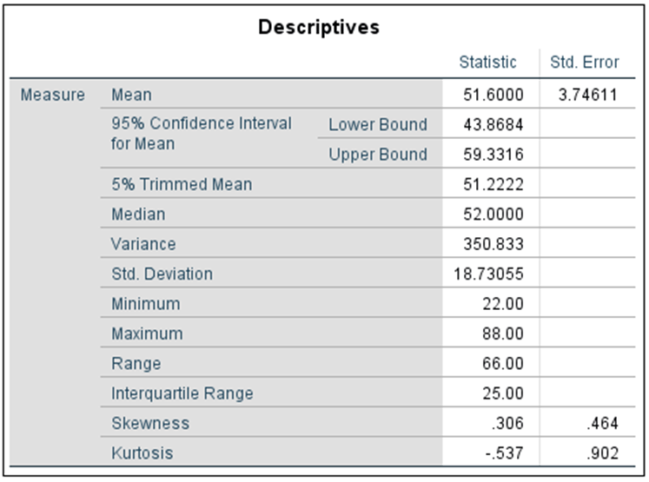

Comments on the homework
Due Friday
Please put you name in the document you are turning in.
Don’t just turn in raw output from SPSS
Summarize the information needed to answer the question
Ex. If you are asked for the mean and the standard deviation, do not give us the table produced by SPSS.
Say something like “the mean is 51.6 and the standard deviation is 18.73”.

Slide 3
Comments on the homework - Graphs
You should not use a single graph type for every problem that you encounter.
If you can reasonably show all the data, do so.
Explain/Summarize you graphs
Making a graph is one thing, understanding it is another.
Choose the graph that best displays your data.
There are very few times when the “Subject ID” should appear in a plot.

Slide 4
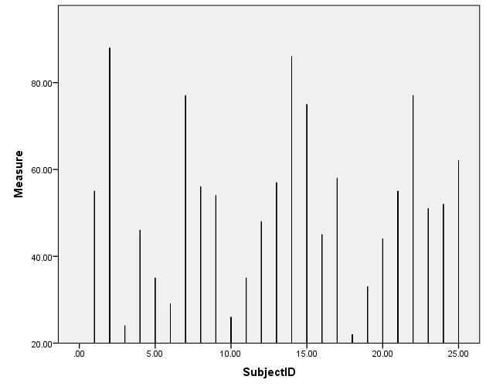
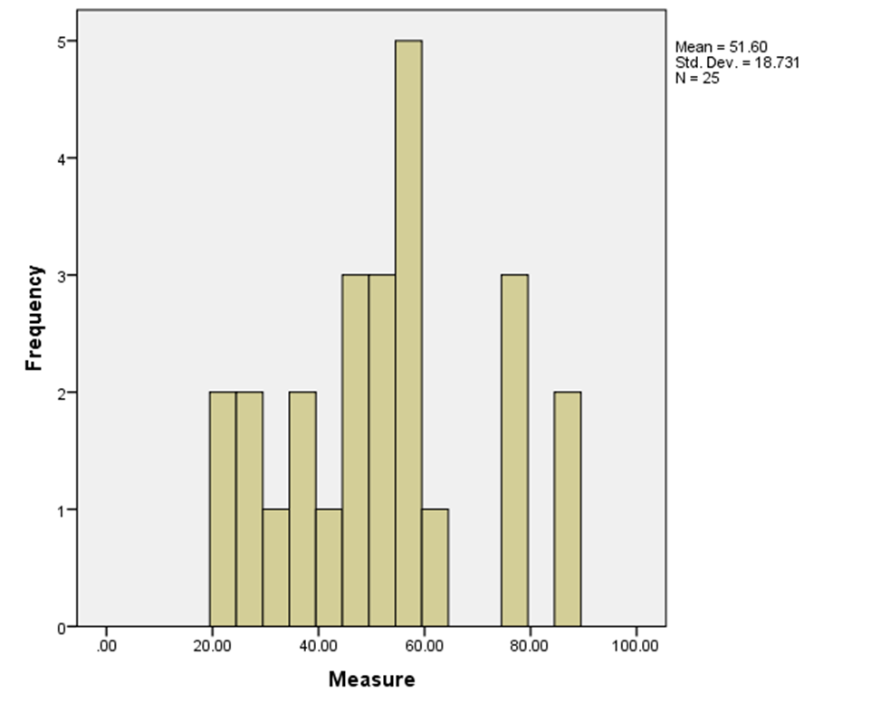
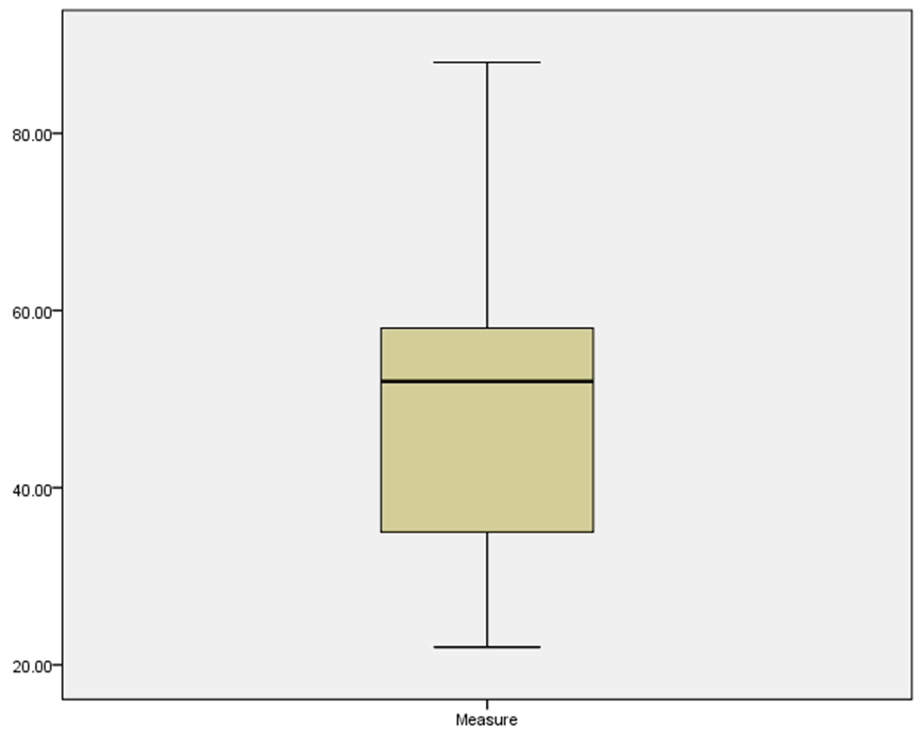
Example
Bad

Slide 5
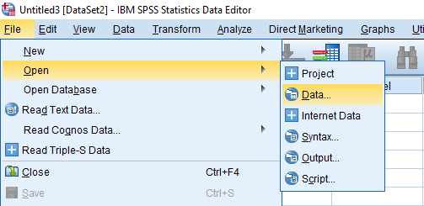
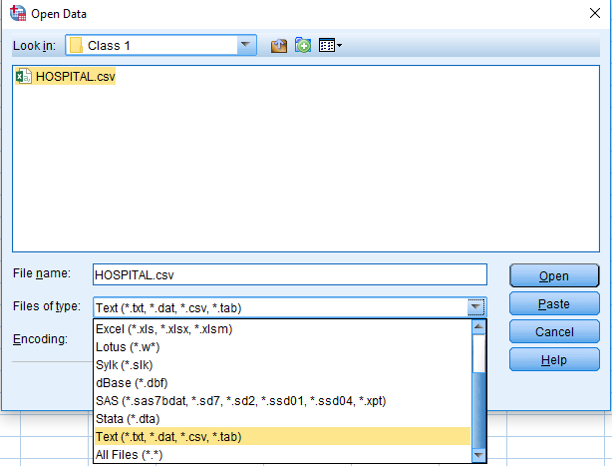
Graphs: Examples
Go to Moodle and download the ‘HOSPITAL.csv’ file.
Once the CSV file is saved to your computer:
File
Open Data
Files of type: Text (.csv)
Select ‘HOSPITAL.csv’
Make sure that the data imported correctly
Check to make sure variable types are correct

Slide 6
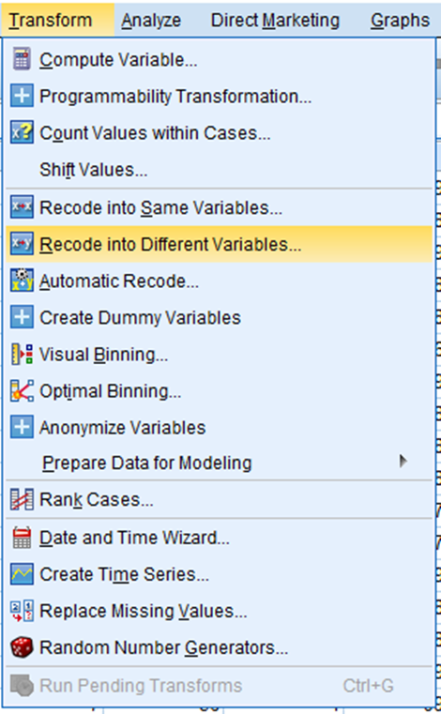
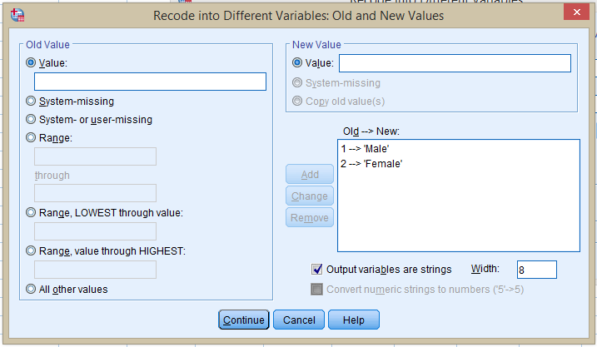
Graphs: Examples
Recode the numeric variable “Sex” into a variable containing strings.
Transform
Recode into different variables…
Select -> Sex
Output Variable Name: ‘Gender’
Click “Old and New Values”
Click “Output Variables are Strings”
Change the values as necessary

Slide 7
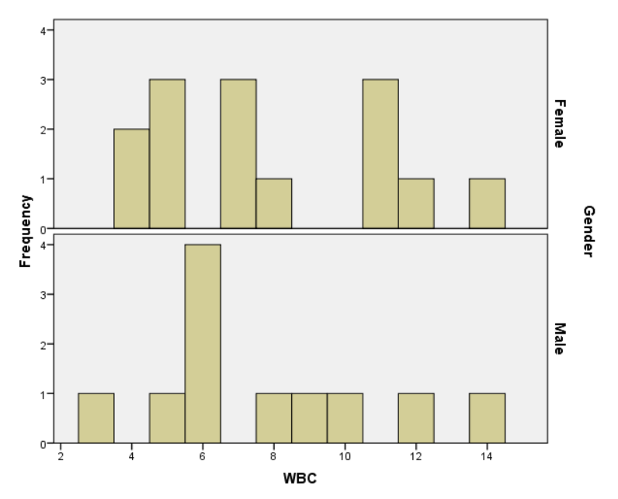
Graphs: Examples
Make a histogram of White Blood Cell Count by Gender
Graphs
Legacy Dialogs
Choose “Histogram”
Variable– WBC
Panel By Rows – Gender
Click “Ok”

Slide 8
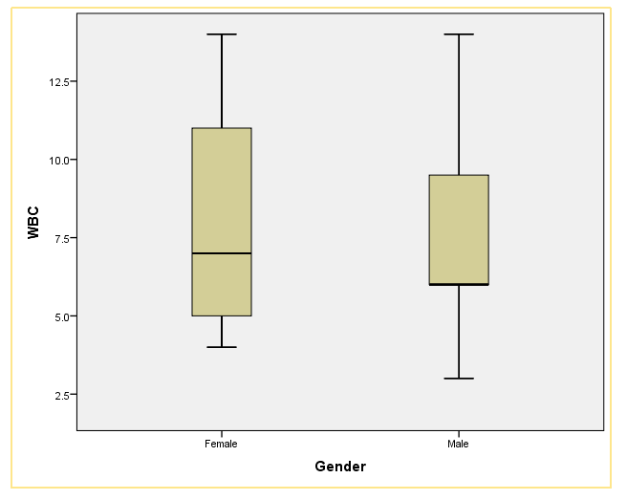
Graphs: Examples
Make a boxplot of White Blood Cell Count by Gender
Graphs
Legacy Dialogs
Choose “Boxplot”
Select “Simple” & “Summaries for groups of cases”
Y Axis – WBC
X Axis – Gender
Click “Ok”

Slide 9
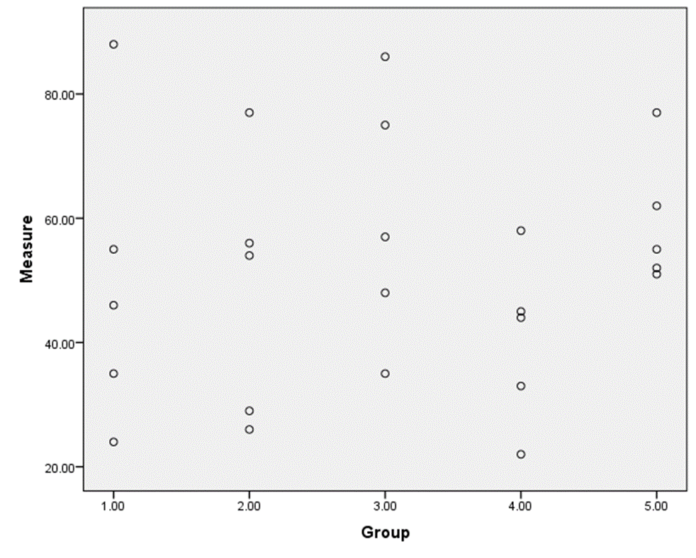
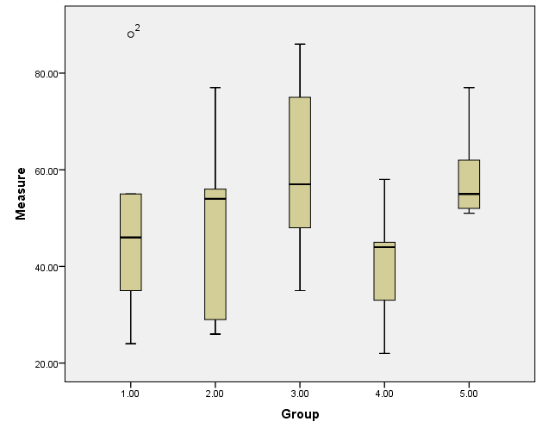
Graphs: Small Data Sets

Slide 10
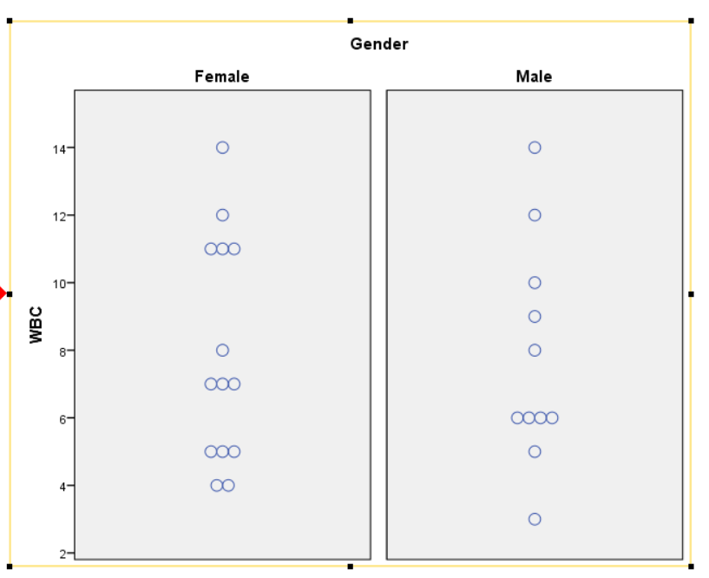
Graphs: Examples
Make a dotplot of White Blood Cell Count by Gender
Graphs
Legacy Dialogs
Choose “Scatter/Dot”
Simple Dot
X Axis – WBC
Columns – Gender
Click “Options” and choose “Symmetric”
Click “Ok”

Slide 11
Tables
Tables can be generate quickly for nominal variables, but first lets dichotomize WBC.
Transform
Recode into different variables…
Select -> WBC
Output Variable Name: ‘WBCCat’
Click “Old and New Values”
Check “Output Variables are Strings”
0-7 = Low WBC
7-20 = High WBC
Click “Continue”
Click “OK”

Slide 12
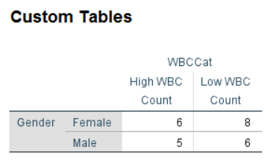
Tables: Exercise
Analyze
Tables
Custom Tables
Click “Ok”
Drag the variables to either row or columns
Click “Ok”

Slide 13
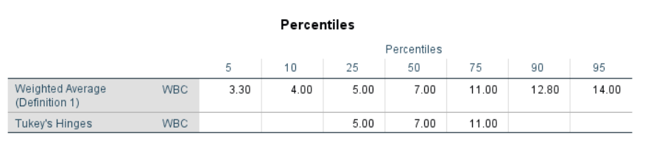
Percentiles
SPSS does not give percentiles by default.
Analyze
Descriptive Statistics
Explore
Click “Statistics”
Check “Percentiles”
Click “Continue” and “Ok”

Slide 14
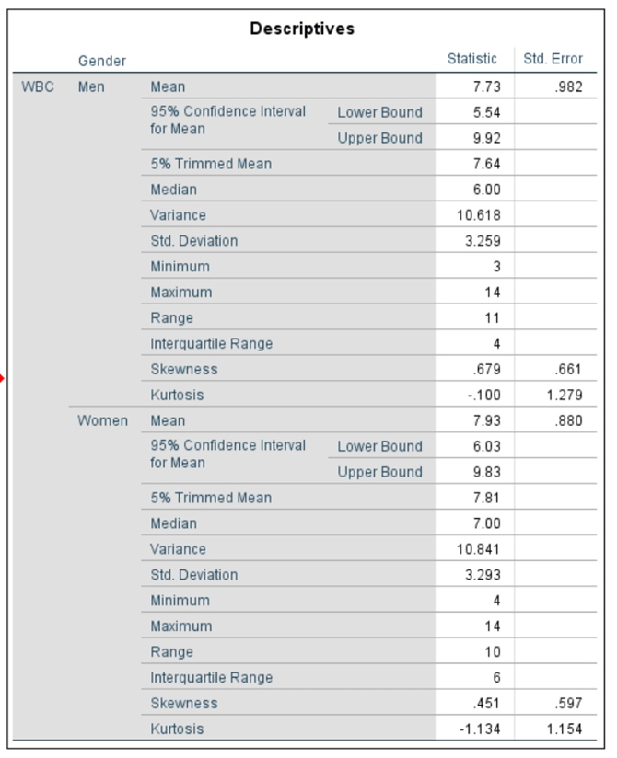
Variability
Measure of variability include…
Range
IQR
Variance
Standard Deviation

Slide 15
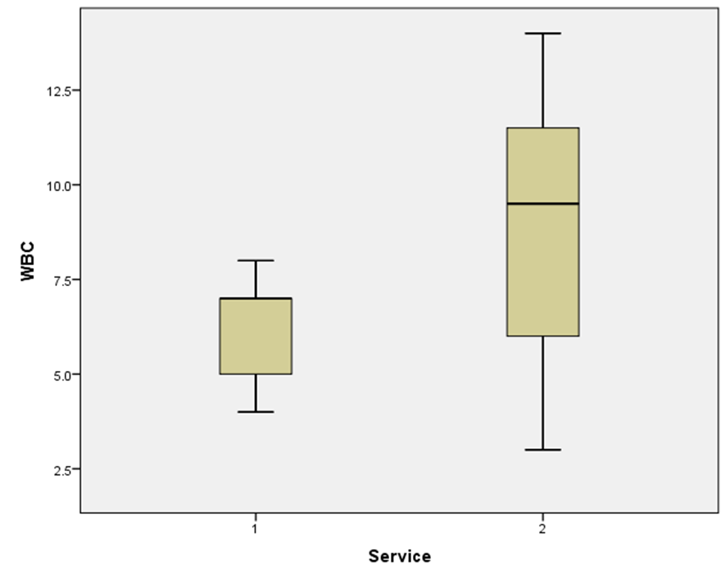
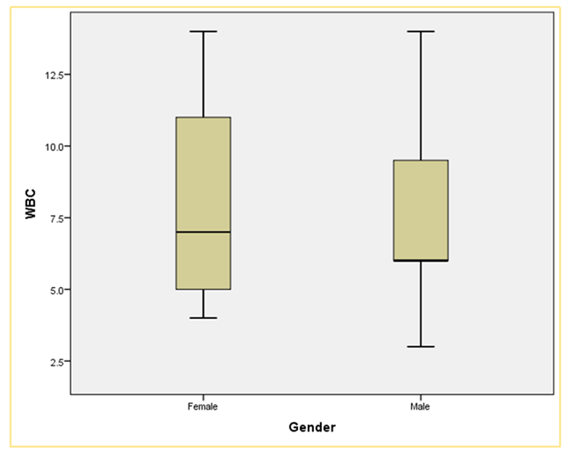
Variability
Graphs are helpful when want to observe the variability of data or check for similar variability among groups.
Different variability
Similar variability

